Slide 1
UNIT – II
Contents
Functions
Defining a Function, Calling a Function, Types of Functions, Function arguments, Anonymous Functions, Global and Local Variables
String Manipulation
Accessing Strings, Basic Operations, String slices, Functions and Methods
Lists
Accessing list, Operations, working with lists Function and Methods
Tuple
Accessing tuples, Operations , working with tuples
Dictionaries
Accessing Values in Dictionaries, working with dictionaries, Properties Functions and Methods

Slide 2
Defining a Function:
A function is a group of statements that exist within a program for the purpose of performing a specific task.
To create a function you write its definition. Here is the general format of a function definition in Python:
Syntax:
def function_name():
statement
statement
etc.

Slide 3
The first line is known as the function header. It marks the beginning of the function definition.
The function header begins with the key word def, followed by the name of the function, followed by a set of parentheses, followed by a colon.
Beginning at the next line is a set of statements known as a block. A block is simply a set of statements that belong together as a group.
Ex:
def message():
print('I am Sreevidya,')
print(‘teaching Python for IT Students.')
This code defines a function named message. The message function contains a block with two statements. Executing the function will cause these statements to execute.

Slide 4
Calling a Function
function definition specifies what a function does, but it does not cause the function to execute. To execute a function, you must call it.
When a function is called, the interpreter jumps to that function and executes the statements in its block.
When the end of the block is reached, the interpreter jumps back to the part of the program that called the function
Ex: def message(): #function definition
print("I am a Student")
print("I am learning Python Programming Language")
message() # function calling
Program Output:
I am a Student
I am learning Python Programming Language

Slide 5
Types of Functions
Basically, we can divide functions into the following two types:
1.Built-in functions - Functions that are built in Python.
2.User-defined functions - Functions defined by the users themselves.

Slide 6
Python Built -in Functions
https://docs.python.org/3/library/functions.html
Functions that readily come with Python are called built-in functions.
The Python interpreter has a number of functions that are always available for use. These functions are called built-in functions.
For example, print() function prints the given object to the standard output device (screen) or to the text stream file.
In Python 3.12.2 (latest version), there are 68 built-in functions. They are listed below alphabetically.
Notes:
Rohita yamaganti

Slide 7
Built-in Functions
A abs() aiter() all() anext() any() ascii() B bin() bool() breakpoint() bytearray() bytes() C callable() chr() classmethod() compile() complex() D delattr() dict() dir() divmod() | E enumerate() eval() exec() F filter() float() format() frozenset() G getattr() globals() H hasattr() hash() help() hex() I id() input() int() isinstance() issubclass() iter() | L len() list() locals() M map() max() memoryview() min() N next() O object() oct() open() ord() P pow() print() property() | R range() repr() reversed() round() S set() setattr() slice() sorted() staticmethod() str() sum() super() T tuple() type() V vars() Z zip() __import__()
Built-in Functions
A abs() aiter() all() anext() any() ascii() B bin() bool() breakpoint() bytearray() bytes() C callable() chr() classmethod() compile() complex() D delattr() dict() dir() divmod() | E enumerate() eval() exec() F filter() float() format() frozenset() G getattr() globals() H hasattr() hash() help() hex() I id() input() int() isinstance() issubclass() iter() | L len() list() locals() M map() max() memoryview() min() N next() O object() oct() open() ord() P pow() print() property() | R range() repr() reversed() round() S set() setattr() slice() sorted() staticmethod() str() sum() super() T tuple() type() V vars() Z zip() _ __import__()
Notes:
Rohita yamaganti

Slide 8
2. User-defined functions
Functions that we define ourselves to do certain specific tasks are referred to as user-defined functions.
If we use functions written by others in the form of library, it can be termed as library functions.
All the other functions that we write on our own, fall under user-defined functions.
So, our user-defined function could be a library function to someone else.
Advantages of user-defined functions
User-defined functions help to decompose a large program into small segments which makes program easy to understand, maintain and debug.
If repeated code occurs in a program. Function can be used to include those codes and execute when needed by calling that function.
Programmers working on large project can divide the workload by making different functions.

Slide 9
1. Fruitful function
2. void function
Fruitful function:
A function that returns a value
All built-in functions, math functions produce results.
Calling the function generates a value, which we usually assign to a variable or use as part of an expression.
Ex:
def area(radius):
temp = math.pi * radius**2
return temp
Ex:
def absolute_value(x):
if x < 0:
return -x
if x > 0:
return x
Notes:
Rohita yamaganti

Slide 10
2. void function:
A function that doesn’t return a value.
void functions might display something on the screen or have some other effect, but they don’t have a return value.
Ex:
def print_twice(x):
print(x)
print(x)
print_twice('Spam')
Output:
Spam
Spam

Slide 11
Function arguments:
we can call a function by using the following types of formal arguments:
Required arguments
Keyword arguments
Default arguments
Variable-length arguments(Arbitrary arguments)
Positional arguments

Slide 12
Required arguments:
Required arguments are the arguments passed to a function in correct positional order. Here, the number of arguments in the function call should match exactly with the function definition.
Ex
def printme(str):
print(“Hello,”+str)
printme(“students”)
To call the function printme(), you definitely need to pass one argument, otherwise it would give a syntax error

Slide 13
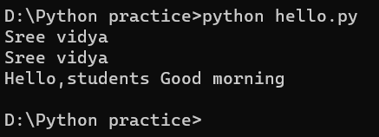
Keyword arguments:
Keyword arguments are related to the function calls.
The idea is to allow the caller to specify the argument name with values so that the caller does not need to remember the order of parameters.
This allows you to skip arguments or place them out of order because the Python interpreter is able to use the keywords provided to match the values with parameters.
Ex1:
# Keyword Arguments example program
def Teacher(firstname,lastname):
print(firstname,lastname)
# function calling with keyword arguments
Teacher('Sree','vidya')# type1
Teacher(lastname='vidya',firstname='Sree')
#type2 can be given in any order
Ex2: def printme(name, msg):
print("Hello,"+name+' '+msg)
printme(name="students", msg="Good morning")

Slide 14
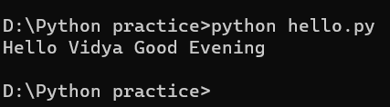
Default arguments:
A default argument is an argument that assumes a default value if a value is not provided in the function call for that argument.
Ex:
def printme(name = " friend", msg=" Good Evening"):
print('Hello '+name+msg)
printme("Vidya")
printme() #Guess the o/p

Slide 15
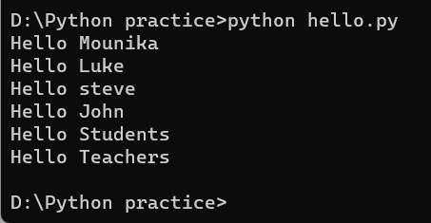
.
Variable-length arguments(Arbitrary arguments):
These arguments are called variable-length arguments and are not named in the function definition, unlike required and default arguments. In Python Arbitrary Keyword Arguments, *args, and **kwargs can pass a variable number of arguments to a function using special symbols. There are two special symbols:
*args in Python (Non-Keyword Arguments)
**kwargs in Python (Keyword Arguments)
Ex: If you do not know how many arguments that will be passed into your function, add a * before the parameter name in the function definitionThis way the function will receive a tuple of arguments, and can access the items accordingly
#1.Variable length Non-keyword arguments(*args)
def greet(*names):
for name in names:
print("Hello",name)
greet("Mounika","Luke","steve","John")
greet("Students","Teachers")
Notes:
Rohita yamaganti

Slide 16
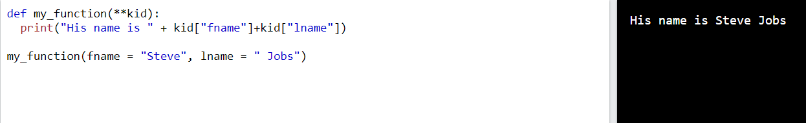
Ex: 2. Variable length keyword arguments(**kwargs)
If you do not know how many keyword arguments that will be passed into your function, add two asterisks ** before the parameter name in the function definition.
This way the function will receive a dictionary of arguments, and can access the items accordingly:

Slide 17
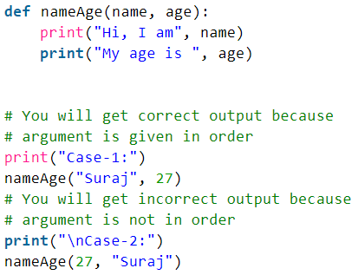
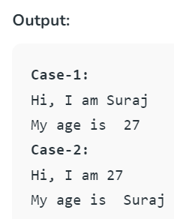
Positional Arguments
Positional arguments are the one where the arguments have to be passed in the same order as
defined in the function. If order is changed, output also changes and doesn’t get the expected
Output.
Ex: for Positional Arguments

Slide 18
Recursion
Advantages of Recursion
Recursive functions make the code look clean and elegant.
A complex task can be broken down into simpler sub-problems using recursion.
Sequence generation is easier with recursion than using some nested iteration.
Disadvantages of Recursion
Sometimes the logic behind recursion is hard to follow through.
Recursive calls are expensive (inefficient) as they take up a lot of memory and time.
Recursive functions are hard to debug.

Slide 19
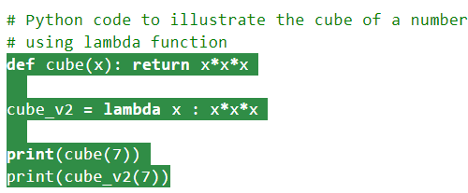
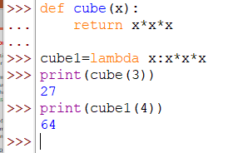
Anonymous Functions:
A function which does not contain any name is known as a lambda function or Anonymous function.
Syntax: lambda arguments: expression
Lambda function we can assign to the variable and we can call the function through that variable.
syntax: ASSIGNED VARIABLE = lambda ARGUMENT : ACTION
x = lambda x : x*2
Ex: myfun=lambda x:x*x
p=myfun(10)
print(p)
Output
100

Slide 20
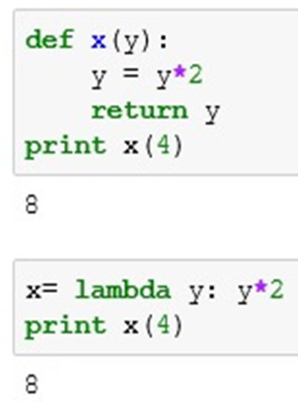

Slide 21
filter():
The filter() function in Python takes in a function and a list as arguments. It filter out all the elements of a sequence, for which the function returns True.
Ex my_list=[1,5,4,6,8,11,3,12]
new_list=list(filter(lambda x:(x%2==0),my_list))
print(new_list)
Output
[4,6,8,12]
map():
The map() function in Python takes in a function and a list as argument. The function is called with a lambda function and a new list is returned which contains all the lambda modified items returned by that function for each item.
Ex my_list=[1,5,4,6,8,11,3,12]
new_list=list(map(lambda x:( x*x),my_list))
print(new_list)
Output [1,25,16,36,64,121,9,144]

Slide 22
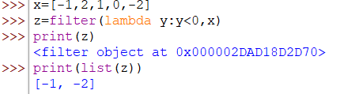
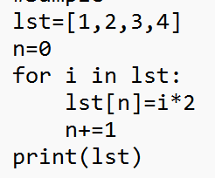

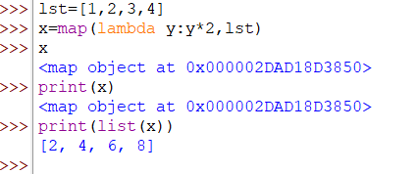
x=[-1,2,1,0,-2]
z=filter(lambda y:y<0,x)
print(list(z))
[-1, -2]

Slide 23
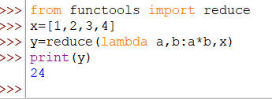

reduce():
The reduce() function in Python takes in a function and a list as argument. The function is called with a lambda function and a list and a new reduced result is returned.
This performs a repetitive operation over the pairs of the list. This is a part of functools module.
Ex:
from functools import reduce
li = [5, 8, 10, 20, 50, 100]
sum = reduce((lambda x, y: x + y), li)
print (sum)

Slide 24
Global Variables:
A global variable is accessible to all the functions in a program file.
When a variable is created by an assignment statement that is written outside all the functions in a program file, the variable is global.
Ex:
my_value = 10
def show_value():
print(my_value)
show_value()
Program Output
10

Slide 25
In order to modify the global variables data with in the function we should use global declaration with in the function.
EX:
a=1000
b=2000
def f1():
global a
global b
print(a)
print(b)
a=3000
b=4000
def f2():
print(a)
print(b)
f1()
f2()
Output:
1000
2000
3000
4000

Slide 26
Local Variables:
A local variable is created inside a function and cannot be accessed by statements that are outside the function.
Different functions can have local variables with the same names because the functions cannot see each other’s local variables.
EX
def get_name():
name = input('Enter your name: ')
def main():
get_name()
print('Hello', name) # This causes an error!
main()

Slide 27
Mutable V/s Immutable Data Types :
Mutable Data Type | Immutable Data Type
Sequences can be modified after creation | 1. Sequences cannot be modified after creation
2. Ex: Lists, Dictionary, Sets | 2. Ex: Strings, Tuples
3. Operations like add, delete and update can be performed | 3. Operations like add, delete and update cannot be performed

Slide 28
Strings:
In Python, string is a sequence of Unicode character. Unicode was introduced to include every character in all languages and bring uniformity in encoding.
Create a string:
Strings can be created by enclosing characters inside a single quote ( ‘ ), double quotes ( “ ) and triple code ( “ “ “ )
It must start and end with same type of quote
Triple quotes are used to span string across multiple lines
Index starts from zero
Can be accessed using negative indices. Last character will start with
-1 and traverses from right to left

Slide 29
Syntax:
word = ‘Python Programming’
sentence = “ Object Oriented Programming”
paragraph =“ “ “ Python is a Object Oriented Programming Language. It is a Beginners Language “”’
Example :
my_string = ‘Hello‘
print(my_string)
my_string1 = input("Enter a string")
print(my_string1)
my_string2 = """Hello, welcome to the world of Python"""
print(my_string2)

Slide 30

Access characters in a string:
We can access individual characters using indexing and a range of characters using slicing. Index starts from 0.
Note: Trying to access a character out of index range will raise an Index Error.
The index must be an integer. We can't use float or other types, this will result into Type Error.
Python also allows negative indexing for its sequences.
Example
str = 'program’ print('str = ', str)
#first character print('str[0] = ', str[0])
#last character print('str[-1] = ', str[-1])
#slicing 2nd to 5th character print('str[1:5] = ', str[1:5])

Slide 31
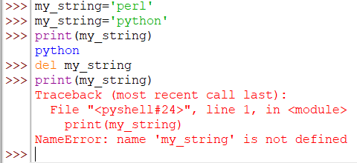
change or delete a string:
Strings are immutable. This means that elements of a string can not be changed once it has been assigned. We can simply reassign different strings to the same name.
We can not delete or remove characters from a string. But deleting the string entirely is possible using the keyword del.
Example:

Slide 32
Concatenation of Two or More Strings:
Joining of two or more strings into a single one is called concatenation. The + operator does this in Python.
The * operator can be used to repeat the string for a given number of times.
Example:
str1 = ‘Hello’
str2 ='World!'
# using +
print('str1 + str2 = ', str1 + str2)
# using *
print('str1 * 3 =', str1 * 3)

Slide 33

String Formatting Operator:
One of Python's coolest features is the string format operator %.
This operator is unique to strings and makes up for the pack of having functions from C's printf() family.
%s : string conversion via str() prior to formatting
%d : signed decimal integer
%f : floating point real number
Example Output:
%d, %i, %o , %u , %x , %X , %e , %E , %f , %F , %g , %G , %c , %r , %s, %%

Slide 34



Escape Sequence:
If we want to print a text like –He said, "What‘s there?"-we can neither use single quote or double quotes.
This will result into Syntax Error as the text itself contains both single and double quotes.
One way to get around this problem is to use triple quotes. Alternatively, we can use escape sequences.
An escape sequence starts with a backslash and is interpreted differently.
If we use single quote to represent a string, all the single quotes inside the string must be escaped. Similar is the case with double quotes
Example
# using triple quotes print('''He said, "What's there?"''')
# escaping single quotes print('He said, "What\'s there?"')
# escaping double quotes print("He said, \"What's there?\"")

Slide 35
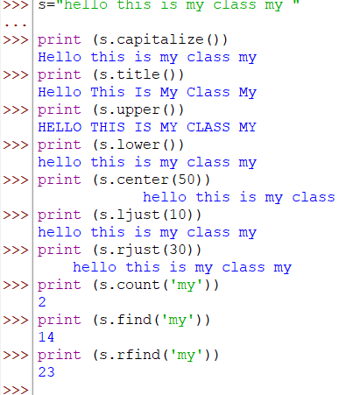
String methods with example:
s="hello this is my class my "
print (s.capitalize()) # Copy of s with only the first character capitalized
print (s.title() ) # Copy of s first character of each word capitalized
print (s.upper()) # copy of s all characters converted to uppercase
print (s.lower() ) # Copy of s in all lowercase letters
print (s.center(50)) #Center s in a field of given width
print (s.ljust(10)) # Like center, but s is left-justified
print (s.rjust(30)) #Like center, but s is right-justified
Print(s.count('my')) #Count the number of occurrences of substring in s
print (s.find('my')) #Find the first position where sub occurs in s
print (s.rfind('my')) #Like find, but returns the right-most position(index)

Slide 36

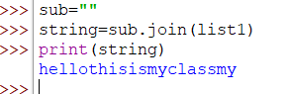
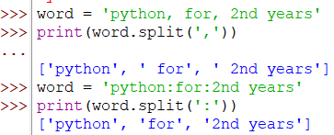

print (s.replace('my', 'one')) #Replace occurrences of oldsub in s with new sub
list1= s.split() #Split s into a list of substrings
print (list1)
sub="“
string=sub.join(list1) # Concatenate list of strings into one large print string using s as separator.
word = ‘python, for, 2nd years'
# Splits at ','
print(word.split(','))
word = ‘python:for:2nd years'
# Splitting at ':'
print(word.split(':'))
word = ' pythoncforc2ndcyears '
# Splitting at ‘c’
print(word.split(‘c'))

Slide 37
String Operations and Functions:
Concatenation :
-Strings can be concatenated with “+ “ operator
“Hello” + “World” will result in HelloWorld
Repetition :
-Repeated concatenation of string can be done using asterisk operator “ * “
“Hello” * 3 will result in “HelloHelloHello”
Indexing:
-“Python” [0] will result in “P”
Slicing:
-Substrings are created using two indices in a square bracket separated by a “ :”
-“Python”[2:4]will result in “th”
Size
-prints: length of string
len(“python”) will result in 6

Slide 38
Escape Characters:
Following table is a list of escape or non-printable characters that can be represented With backslash notation.
An escape character gets interpreted; in a single quoted as well as double quoted strings.
Escape character Meaning
\a Bell or Alert
\b Backspace
\n New Line
\t Horizontal tab space
\v Vertical tab space
\r Enter button
\x Character X
\\ Display single \

Slide 39
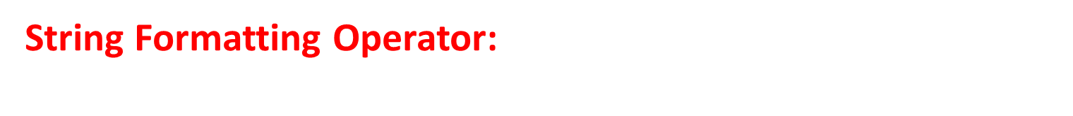
Format specifier | Description
%s | Specifies the String
%c | Specifies a single character
%d | Specifies the integer
%f | Specifies the float. Any number of digits can be present after decimal point
%<space>.<number>f | Specifies the float. <space> denotes the number of space to append before printing the number. <number> denotes the number of digits to be present after the decimal point.
%x / %X | Specifies the hexadecimal representation of the value
%o | Specifies the octal representation of a value
%e / %E | Specifies the floating numbers in exponential format
%g / %G | Similar to %e/%E. Specifies the exponential format only if the exponent is greater than -4

Slide 40
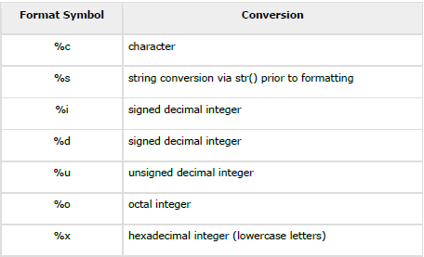
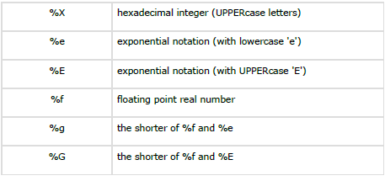
String Formatting Operator:

Slide 41
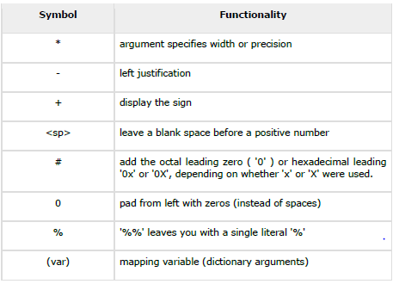


Slide 42
List:
Creating a list is as simple as putting different comma-separated values between square brackets
Important thing about a list is that items in a list need not be of the same type
An ordered group of sequences enclosed inside square brackets and separated by symbol ,
List are mutable type,Python will not create a new list if we modify an element in the list.
Syntax:
list1= [ ] # Creation of empty List
list2= [ Sequence1, ] # In this case comma is not mandatory
list3= [ Sequence1, Sequence2]
Ex: language=[“Python”]
languages =[“Python”, “C”,”C++”,”Java”, ”Perl”, ”R”]

Slide 43
A list can be composed by storing a sequence of different type of values separated by commas.
The elements are stored in the index basis with starting index as 0.
Ex:
data1=[1,2,3,4]
data2=['x','y','z']
data3=[12.5,11.6]
data4=['raman','rahul']
data5=[]
data6=['abhinav',10,56.4,'a']

Slide 44
Accessing Values in Lists
A list can be created by putting the value inside the square bracket and separated by comma.
Syntax:
<list_name>=[value1,value2,value3,...,value n]
For accessing list :
<list_name>[index]
list1 = ['physics', 'chemistry', 1997, 2000]
list2 = [1, 2, 3, 4, 5, 6, 7 ]
print ("list1[0]: ", list1[0])
print ("list2[1:5]: ", list2[1:5])
print (“list1[0:] : “, list1[0:])
Output
list1[0]: physics
list2[1:5]: [2, 3, 4, 5]
list1[0:] : ['physics', 'chemistry', 1997, 2000]

Slide 45
Elements in a Lists:
Data=[1,2,3,4,5];
Data[0]=1=Data[-5],
Data[1]=2=Data[-4],
Data[2]=3=Data[-3],
Data[3]=4=Data[-2],
Data[4]=5=Data[-1].
Note: Internal Memory Organization:
List do not store the elements directly at the index. In fact a reference is stored at each index which subsequently refers to the object stored somewhere in the memory. This is due to the fact that some objects may be large enough than other objects and hence they are stored at some other memory location.

Slide 46
List operations
Adding Lists : The + operator concatenates lists:
a = [1, 2, 3] # list1
b = [4, 5, 6] # list2
c = a + b # list3
print c
Output : [1,2, 3, 4, 5, 6]
Replicating lists: Similarly, the * operator repeats a list a given number of times:
a= [7, 8, 9]
b=a*3
print b
Output [7, 8, 9, 7, 8, 9, 7, 8, 9]
Note: '+'operator implies that both the operands passed must be list, else gives error
list1=[10,20]
list1+30
print list1 # error

Slide 47
List membership:
in and not in are Boolean operators that test membership in a sequence.
Example
list1=[1,2,3,4,5,6]
print(5 in list1)
Output
True
list1=[1,2,3,4,5,6]
print(-5 in list1)
Output
False

Slide 48
List slicing:
A subpart of a list can be retrieved on the basis of index. This subpart is known as list slice.
Example:
fruits=["banana","orange","apple","kiwi"]
print (fruits[1:3])
print (fruits[:3])
print (fruits[:])
Output
['orange', 'apple']
['banana', 'orange', 'apple']
['banana', 'orange', 'apple', 'kiwi']
Note: If the index provided in the list slice is outside the list, then it raises an IndexErrorexception

Slide 49
Other Operations:
Apart from above operations various other functions can also be performed on List such as Updating, Appending and Deleting elements from a List:
Updating elements in a List:
To update or change the value of particular index of a list, assign the value to that particular index of the List.
Syntax:
<list_name>[index]=<value>

Slide 50
Updating Lists
list = ['physics', 'chemistry', 1997, 2000];
print ("Value available at index 2 : “,list[2])
list[2] = 2001;
print ("New value available at index 2 : “,list[2])
print(list)
Output
Value available at index 2 : 1997
New value available at index 2 : 2001
['physics', 'chemistry', 2001, 2000]
Notes:
Rohita yamaganti

Slide 51
Appending elements to a List:
append() method is used to append i.e., add an element at the end of the existing elements.
Syntax: <list_name>.append(item)
Eg: list1=[10,"rahul",'z']
print ("Elements of List are:”)
print (list1)
list1.append(10.45)
print("List after appending:“)
print (list1)
Output:
Elements of List are:[10,'rahul','z']
List after appending:[10,'rahul','z',10.45]

Slide 52
Delete List Elements:
del statement can be used to delete an element from the list. It can also be used to delete all items from start Index to end Index.
Example:
list1 = ['physics', 'chemistry', 1997, 2000];
print (list1)
del (list1[2])
print ("After deleting value at index 2 : “)
print( list1)
Output
['physics', 'chemistry', 1997, 2000]
After deleting value at index 2 :['physics', 'chemistry', 2000]

Slide 53
Functions and Methods of Lists:
There are many Built-in functions and methods for Lists. They are as follows:
List functions:
Function Description
min(list) Returns the minimum value from the given list
max(list) Returns the largest value from the given list
len(list) Returns number of elements in a list
cmp(list1,list2) Compares the two lists
list(sequence) Takes sequence types and converts them to lists

Slide 54
min(list):
The method min() returns the elements from the list with minimum value.
Syntax
min(list)
Example
List1=[80,100,1000]
print ("min(80, 100, 1000) : ", min(List1))
Lst_string=['a', 'zx', 'y']
print ("min['a', 'zx', 'y'] : ", min(Lst_string))
Output:
min[80,100,1000] : 80
min['a', 'zx', 'y'] : 'a'

Slide 55
max(list)
The method max returns the elements from the list with maximum value.
Syntax
max(list)
Example
List1=[80,100,1000]
print ("max(80, 100, 1000) : ", max(List1))
Lst_string=['a', 'zx', 'y']
print ("max['a', 'zx', 'y'] : ",max( Lst_string))
Output:
max[80,100,1000] : 1000
max['a', 'zx', 'y'] : 'zx'

Slide 56
Built-in List Functions
len,min,max,index,count are the built-in functions of List
len(list)
The method len( ) returns the number of elements in the list.
Syntax
len(list)
Example
list1, list2 = [123, 'xyz', 'zara'], [456, 'abc']
print ("First list length : ", len(list1))
print ("Second list length : ", len(list2))
Output
First list length : 3
Second list length :2

Slide 57
cmp(list1,list2): deleted in python 3.x versions, earlier available in python 2.x
Explanation: If elements are of the same type, perform the comparison and return the result. If elements are different types, check whether they are numbers.
If numbers, perform comparison.
If either element is a number, then the other element is returned.
Otherwise, types are sorted alphabetically .
If we reached the end of one of the lists, the longer list is "larger." If both list are same it returns 0.
Eg:
list1=[101,981,'abcd','xyz','m']
list2=['aman','shekhar',100.45,98.2]
list3=[101,981,'abcd','xyz','m']
print(cmp(list1,list2)) #output is -1
print(cmp(list2,list1)) #output is 1
print(cmp(list3,list1)) #output is 0
Notes:
Rohita yamaganti

Slide 58
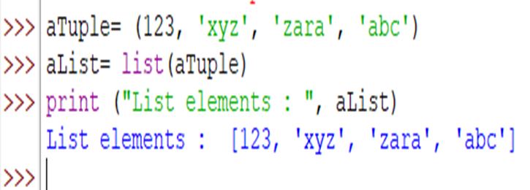
list(seq):
The method list() takes sequence types and converts them to lists. This is used to convert a given tuple into list.
Note: Tuple are very similar to lists with only difference that element values of a tuple can not be changed and tuple elements are put between parentheses instead of square bracket.
Syntax
list(seq)

Slide 59
These are following built-in methods of List:
Methods Description
index(object) Returns the index value of the object.
2. count(object) It returns the number of times an object is repeated in list.
3.pop()/pop(index) Returns the last object or the specified indexed object.It removes the popped object.
4. insert(index,object) Insert an object at the given index.
5. extend(sequence) It adds the sequence to existing list.
6. remove(object) It removes the object from the given List.
7. reverse() Reverse the position of all the elements of a list.
8. sort() It is used to sort the elements of the List.
9.append() appends a passed obj into the existing list.

Slide 60
Built-in List Methods
1.append()
The method append() appends a passed obj into the existing list.
Syntax
list.append(obj)
Example
aList= [123, 'xyz', 'zara', 'abc']
aList.append( 2009 );
print ("Updated List : ", aList)
Output:
Updated List : [123, 'xyz', 'zara', 'abc', 2009]
2.count()
The method count() returns count of how many times obj occurs in list.
Syntax
list.count(obj)

Slide 61
Example
Li= [123, 'xyz', 'zara', 'abc', 123]
print( "Count for 123 : ", Li.count(123))
print( "Count for zara: ", Li.count('zara'))
Output
Count for 123 : 2
Count for zara: 1
3.extend()
The method extend() appends the contents of seq to list.
Syntax
list.extend(seq)
Example
l1= [123, 'xyz', 'zara', 'abc', 123]
l2= [2009, 'matha']
l1.extend(l2)
print( "Extended List : ", l1)
Output
Extended List : [123, 'xyz', 'zara', 'abc', 123, 2009, 'matha']

Slide 62
4.index()
The method index() returns the lowest index in list that obj appears.
Syntax
list.index(obj)
Example
aList= [123, 'xyz', 'zara', 'abc']
print ("Index for xyz : ", aList.index( 'xyz' ) )
print ("Index for zara: ", aList.index( 'zara' ))
Output
Index for xyz : 1
Index for zara: 2
5.insert()
The method insert() inserts object obj into list at offset index.
Syntax
list.insert(index, obj)
Example: li= [123,'xyz','zara','abc']
li.insert( 3, 2009)
print("Final List:",li)
Output:
Final List : [123, 'xyz', 'zara', 2009, 'abc']

Slide 63
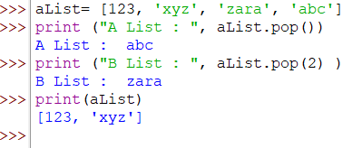
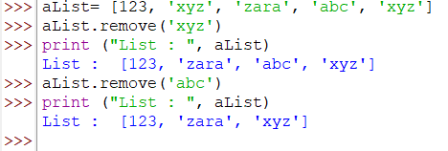
6.pop() The method pop() removes and returns last object or obj from the list.
Syntax: list.pop(obj=list[-1])
Example:
7.remove()
This is the object to be removed from the list.
This method does not return any value but removes the given object from the list.
Syntax
list.remove(obj)
Example

Slide 64
8.reverse()
The method reverse() reverses objects of list in place.
This method does not return any value but reverse the given object from the list.
Syntax
list.reverse()
Example aList= [123, 'xyz', 'zara', 'abc', 'xyz'] Output
aList.reverse() List : ['xyz', 'abc', 'zara', 'xyz', 123]
print ("List : ", aList)
9.sort()
The method sort() sorts objects of list, use compare func if given.
Syntax
list.sort([func])
Example aList= [123, 'xyz', 'zara', 'abc', 'xyz'] Output
aList.sort() List : [123, 'abc', 'xyz', 'xyz', 'zara']
print ("List : ", aList)

Slide 65
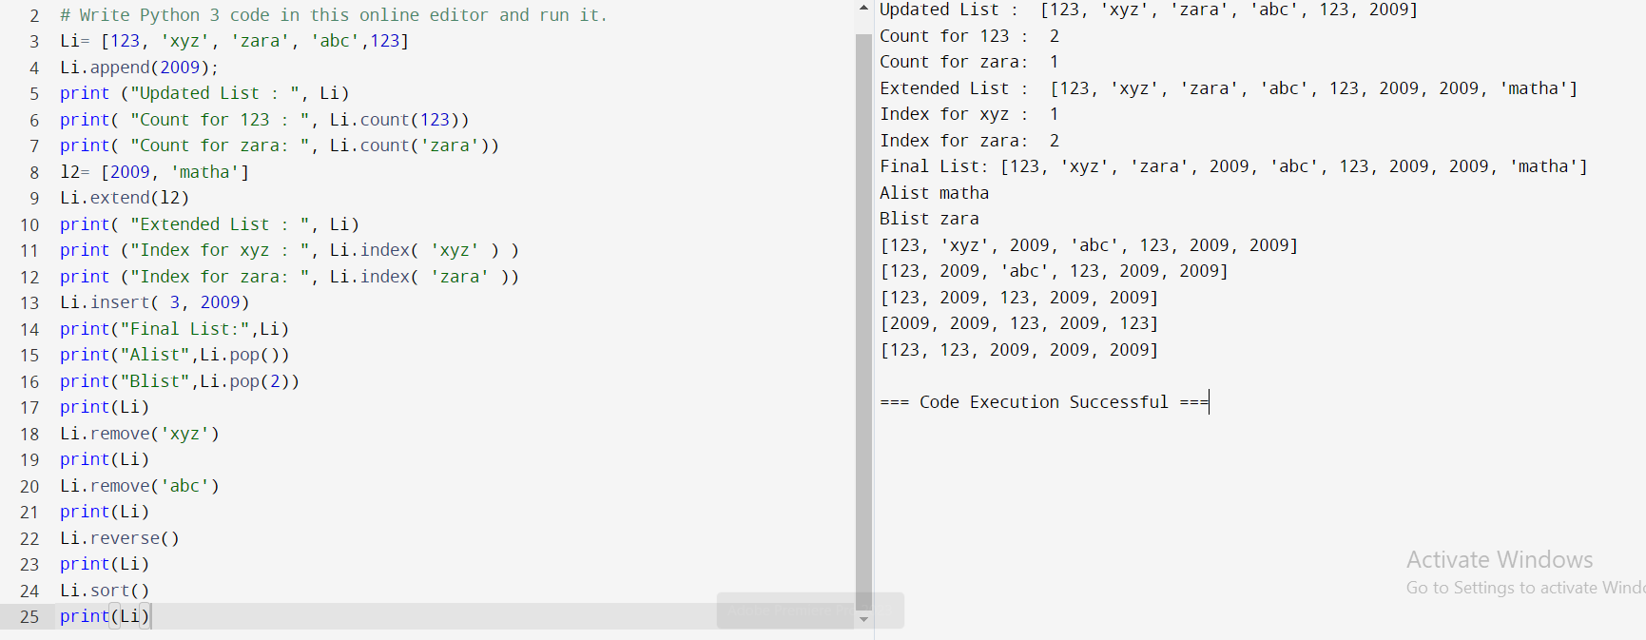

Slide 66
Aliasing
Since variables refer to objects, if we assign one variable to another, both variables refer to the same object
Example a=[1,2,3]
b=a
if a is b:
print “True”
else:
print “False“
Output
True
In this case, the state snapshot looks like this:
a-------[1,2,3]
b-------[1,2,3]
Because the same list has two different names, a and b , we say that it is aliased. Changes made with one alias affect the other

Slide 67
for loop Syntax Or VARIABLE in LIST: BODY
Note: Each time through the loop, the variable i is used as an index into the list, printing the i’th element. This pattern of computation is called a list traversal.
Example 1
friends = ["ram", "laxman", "Bharat", "janaki"]
for friend in friends:
print friend
Output
ram
laxman
Bharat
janaki

Slide 68
Cloning
If we want to modify a list and also keep a copy of the original, we need to be able to make a copy of the list itself, not just the reference. This process is sometimes called cloning, to avoid the ambiguity of the word copy.
The easiest way to clone a list is to use the slice operator:
a=[1,2,3]
b=a[:]#making clone copy
print (b)
print (a)
b[0]=5
print (b)
print (a)
Output
[1, 2, 3]
[1, 2, 3]
[5, 2, 3]
[1, 2, 3]

Slide 69
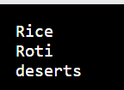
List parameters
Passing a list as an argument actually passes a reference to the list, not a copy or clone of the list. So parameter passing creates an alias for you:the caller has one variable referencing the list, and the called function has an alias, but there is only one underlying list object.
Functions that produce lists
#foods is a list passed as parameter
foods = ["Rice", "Roti", "deserts"]
def my_function(foods):
for x in food:
print(x)
my_function(foods)

Slide 70
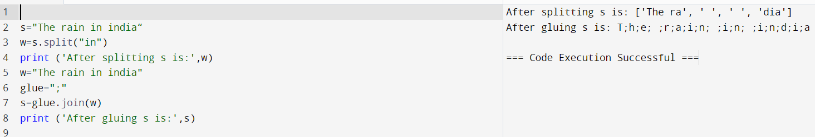
Strings and lists
An optional argument called a delimiter can be used to specify which string to use as the boundary marker between substrings. The following example uses the string “in” as the delimiter:
Example
s="The rain in india“
w=s.split("in")
print (w)
Output['The ra', ' ', ' ', 'dia']
The inverse of the split method is join . You choose a desired separator string, (often called the glue ) and join the list with the glue between each of the elements:
Example
w="The rain in india“
glue=";”
s=glue.join(w)
print (s)
Output : T;h;e; ;r;a;i;n; ;i;n; ;i;n;d;i;a]

Slide 71
Nested lists
A nested list is a list that appears as an element in another list. In this list, the element with index 3 is a nested list:
Example
nested = ["hello", 2.0, 5, [10, 20]]
print(nested[3])
Output [10, 20]
Nested lists
To extract an element from the nested list, we can proceed in two steps:
Example
nested = ["hello", 2.0, 5, [10, 20]]
print(nested[3][0]) Output 10
Matrices
Nested lists are often used to represent matrices. For example, the matrix:
mx= [[1, 2, 3], [4, 5, 6], [7, 8, 9]]mx is a list with three elements, where each element is a row of the matrix. We can select an entirerow from the matrix in the usual way:>>> mx[1][4, 5, 6]

Slide 72
difference between append() and extend()
The method append adds its parameter as a single element to the list, while extend gets a list and adds its content.
Example
first = [10,20,30]
second = [40,50,60]
first.append([70,80,90])
second.extend([100,110,120])
print first
print second
Output [10, 20, 30, [70, 80, 90]]
[40, 50, 60, 100, 110, 120]

Slide 73
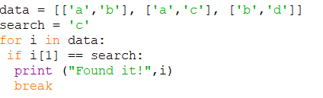

Searching lists:

Slide 74
Tuples
An ordered group of sequence seperated by symbol, and enclosed inside the parenthesis
A tuple is a sequence of immutable objects, therefore tuple can not be changed
In Python, tuple is similar to a list.Only the difference is that list is enclosed between square bracket, tuple between parenthesis and List have mutable objects where as Tuple have immutable objects.
NOTE:If Parenthesis is not given with a sequence, it is by default treated as Tuple.
Advantages of Tuple over List
Since tuple are immutable, iterating through tuple is faster than with list. So there is a slight performance boost.
It makes the data safe as tuples are immutable and hence can not be changed.
Tuples that contain immutable elements can be used as key for a dictionary. With list, this is not possible.
Tuples are used for String formatting.

Slide 75

Creating a Tuple
A tuple is created by placing all the items (elements) inside a parentheses(), separated by comma.
The parentheses are optional but is a good practice to write it.
A tuple can have any number of items and they may be of different types(integer, float, list,stringetc.).
Syntax:tuple1=() #creation of empty tuple
tuple2=(Sequence1,)# ,symbol is mandatory with out which it becomes just a string assignment operator
tuple3=(Sequence1,Sequence2)
Example
my_tuple=(1,3.2,"mouse",[8,4,6],(1,2,3))
print(my_tuple)
Notes:
Rohita yamaganti

Slide 76
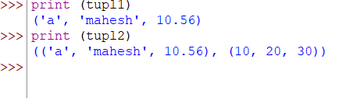
Tuples can also be nested.
Ex-
tupl1='a','mahesh',10.56
tupl2=tupl1,(10,20,30)
print (tupl1)
print (tupl2)
Output:

Slide 77
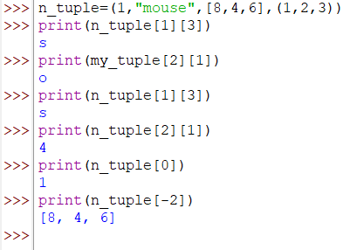
Accessing Elements in a Tuple
We can use the index operator[] to access an item in a tuple where the index starts from 0. So, a tuple having 6 elements will have index from 0 to 5.
Trying to access an element other that(6,7,...)will raise an Index Error.
The index must be an integer, using float or other types will result into Type Error. Likewise ,nested tuple are accessed using nested indexing as shown in the example below.
Python allows negative indexing for its sequences.
Example

Slide 78
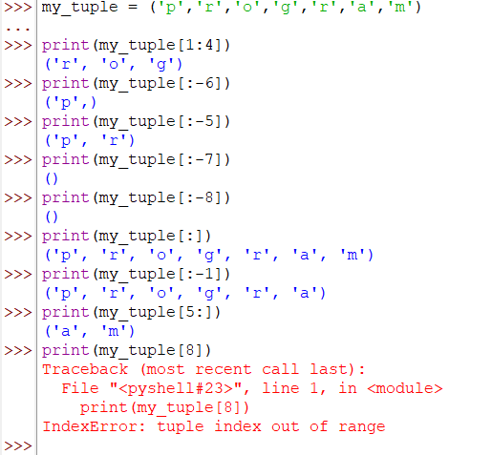
Tuple Operations : Slicing
We can access a range of items in a tuple by using the slicing operator-colon":".
A sub part of a tuple can be retrieved on the basis of index. This subpart is known as tuple slice.
If the index provided in the Tuple slice is outside the list, then it raises an Index Error exception
Example
my_tuple = ('p','r','o','g','r','a','m')
print(my_tuple[1:4]) # starts from 1 ends before 4
print(my_tuple[:-5]) #upto index -5
print(my_tuple[5:]) # starts from index 5 to end
print(my_tuple[:]) #index from start to end
print(my_tuple[-1]) # upto index -1
print(my_tuple) # prints entire tuple

Slide 79
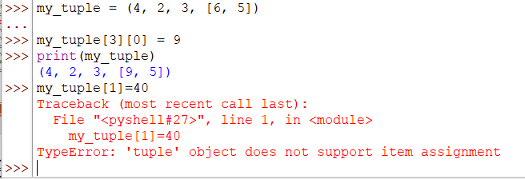
Changing a Tuple
Unlike lists, tuples are immutable. This means that elements of a tuple can not be changed once it has been assigned. But, if the element is a mutable datatype like list,its nested items can be changed. We can also assign a tuple to different values(reassignment).
Example
my_tuple = (4, 2, 3, [6, 5])
my_tuple[3][0] = 9
print(my_tuple)
my_tuple[1]=40

Slide 80
We can use + operator to combine two tuples. This is also called concatenation.
We can also repeat the elements in a tuple for a given number of times using the * operator.
Both + and * operations result into a new tuple.
Example
# Concatenation
print((1, 2, 3) + (4, 5, 6)) # Output: (1, 2, 3, 4, 5, 6)
# Repeat
print(("Repeat",) * 3) # Output: ('Repeat', 'Repeat', 'Repeat')

Slide 81
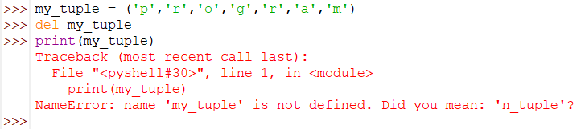
Deleting a Tuple
we cannot delete or remove items or elements from a tuple.
But deleting a tuple entirely is possible using the keyword del.
Example
my_tuple = ('p','r','o','g','r','a','m')
del my_tuple # will delete the entire tuple data
print(my_tuple) # will show an error saying my_tuple is not defined
Tuple Methods
Methods that add items or remove items are not available with tuple. Only the following two methods are available.
count(x) returns the number of items that is equal to x
index(x) returns index of first item that is equal to x
Example
my_tuple = ('a','p','p','l','e',)
print(my_tuple.count('p'))#Output:2
print(my_tuple.index('l'))#Output:3

Slide 82
Tuple functions
all ( T) -Return True if all elements of the tuple are true (or if the tuple is empty).
any( T) -Return True if any element of the tuple is true. If the tuple is empty, return False.
enumerate( T) -Return an enumerate object. It contains the index and value of all the items of tuple as pairs.
len( T) -Return the length (the number of items) in the tuple.
max(T ) -Return the largest item in the tuple.
min( T) -Return the smallest item in the tuple
sorted(T ) -Take elements in the tuple and return a new sorted list (does not sort the tuple itself).
sum( T) -Return the sum of all elements in the tuple.
tuple( T) -Convert an inerrable (list, string, set, dictionary) to a tuple.
cmp( t1,t2) –To compare the two given tuples
tuple(sequence) –Converts the sequence into tuple

Slide 83
cmp(tuple1,tuple2)
Note: Not available under python 3 version
If elements are of the same type, perform the comparison and return the result. If elements are different types, check whether they are numbers
If numbers, perform comparison.
If either element is a number, then the other element is returned.
Otherwise, types are sorted alphabetically.
If we reached the end of one of the lists, the longer list is "larger.“ If both list are same it returns 0.
Eg:
data1=(10,20,'rahul',40.6,'z')
data2=(20,30,'sachin',50.2)
print (cmp(data1,data2))
print (cmp(data2,data1))
data3=(20,30,'sachin',50.2)
print(cmp(data2,data3))
Output:
-1
1
0

Slide 84
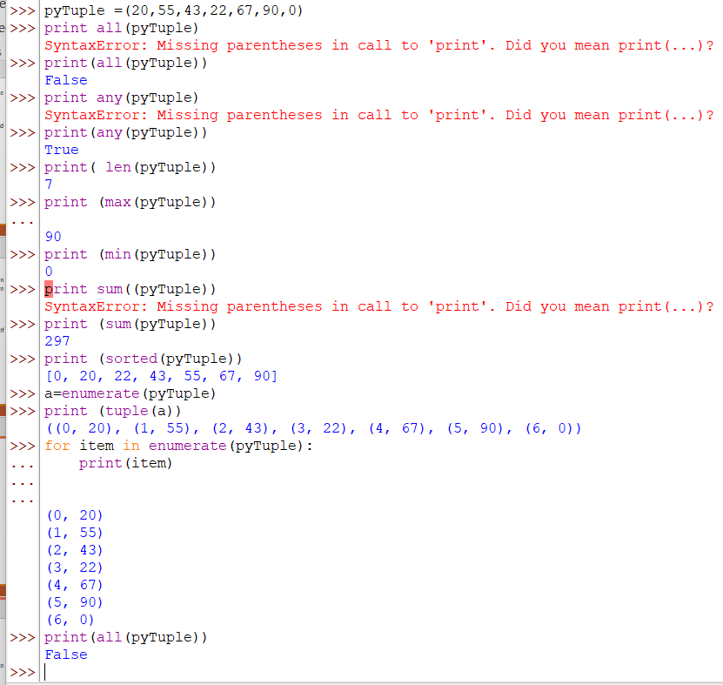
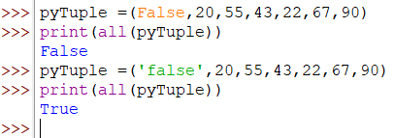
Example
pyTuple =(20,55,43,22,67,90,0) # data=(10,20,‘Ravi',40.6,'z')
print (all(pyTuple))Try out
print (any(pyTuple))
print( len(pyTuple))
print (max(pyTuple))
print (min(pyTuple))
print (sum(pyTuple))
print (sorted(pyTuple))
a=enumerate(pyTuple)
print (tuple(a))
for item in enumerate(pyTuple):
print(item)

Slide 85
Dictionaries:
Python dictionary is an unordered collection of items
Dictionaries are mutable i.e., it is possible to add, modify and delete key-value pairs
Keys are used instead of indexes
Keys are used to access elements in dictionary
Note: keys can be of type- strings, number, list etc
A list of elements with key and value pairs (seperated by symbol:) inside curly braces
Ex: phonebook={“Rani”:9235648766,”Sita”:9989933933}
The key must be unique [Immutable], separated by colon(:) and enclosed with curly braces

Slide 86
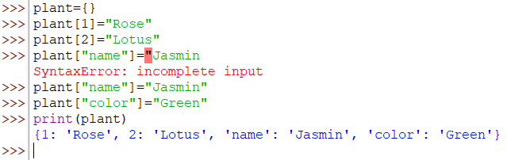
While other compound data types have only value as an element, a dictionary has a set of key & value pair known as item.
Creating a dictionary is as simple as placing items inside curly braces{} separated by comma.
We can also create a dictionary using the built-in function dict()
Dictionary is known as Associative Array
Ex:
plant={} #we can have our own index
plant[1]="Rose“ # number as index
plant[2]="Lotus"
plant["name"]="Jasmin“ # string as index
plant["color"]="Green"
print(plant)

Slide 87
Examples:8/4/2017
# creation of empty dictionary my_dict= {}
# dictionary with integer keys my_dict= {1: 'apple', 2: 'ball'}
# dictionary with mixed keys my_dict= {'name': 'John', 1: [2, 4, 3]}
# using dict( ) my_dict= dict({1:'apple', 2:'ball'})
# from sequence having each item as a pair
my_dict= dict([(1,'apple'), (2,'ball')])
phonebook={}
#creation of empty Dictionary
phonebook={“Ravi”:9247448766}
#Dict.with KVpair
phonebook={“Ravi”:9247448766,”Rahul”:9985933931}
#Dict. With 2 K-V Pairs

Slide 88
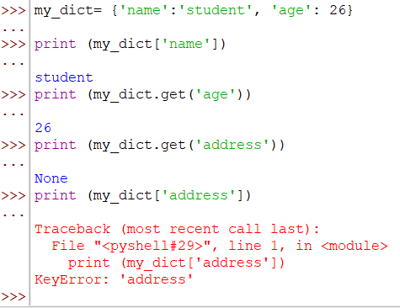
Accessing Elements in a Dictionary
While indexing is used with other container types to access values, dictionary uses keys.
Key can be used either inside square brackets or with the get() method.
The difference while using get() is that it returns None instead of Key Error, if the key is not found.
Example
my_dict= {'name':'student', 'age': 26}
print (my_dict['name'])
print (my_dict.get('age'))
print (my_dict.get('address'))
print (my_dict['address'])
Changing or Adding Elements in a Dictionary
Dictionaries are mutable. We can add new items or change the value of existing items using assignment operator.
If the key is already present, value gets updated, else a new key: value pair is added to the dictionary.
Output

Slide 89
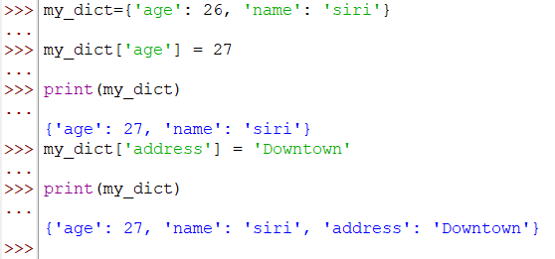
Example
my_dict={'age': 26, 'name': ‘siri'}
my_dict['age'] = 27 # update value
print(my_dict)
my_dict['address'] = 'Downtown' # add item
print(my_dict)
Output

Slide 90
Deleting or Removing Elements from a Dictionary:
pop() -method removes an item with the provided key and returns the value.
popitem() can be used to remove and return an arbitrary item(key,value ) from the dictionary.
All the items can be removed at once using the clear() method.
We can also use the del keyword to remove individual items or the entire dictionary itself.

Slide 91
Example
squares = {1:1, 2:4, 3:9, 4:16, 5:25} # create a dictionary
print(squares.pop(4)) # remove a particular item
print(squares)
Output:16
{1: 1, 2: 4, 3: 9, 5: 25}
squares = {1:1, 2:4, 3:9, 4:16, 5:25} # create a dictionary
print(squares.popitem()) # remove an arbitrary item
Output:(5, 25)
squares = {1:1, 2:4, 3:9, 4:16, 5:25} # create a dictionary
del(squares[5]) # delete a particular item
print(squares)
Output:{1: 1, 2: 4, 3: 9, 4: 16}
squares = {1:1, 2:4, 3:9, 4:16, 5:25} # create a dictionary
squares.clear() # remove all items
print(squares)
Output:{}
Notes:
Rohita yamaganti

Slide 92
Dictionary Comprehension
Dictionary comprehension is an elegant and concise way to create new dictionary from an iterable in Python.
Dictionary comprehension consists of an expression pair(key:value) followed by for statement inside curly braces{}.
Here is an example to make a dictionary with each item being a pair of a number and its square.
Example
squares = {x: x*x for x in range(6)}
print (squares)
Output: {0: 0, 1: 1, 2: 4, 3: 9, 4: 16, 5: 25}
#This code is equivalent to
squares = {}
for x in range(6):
squares[x] = x*x
print(squares)
Output:{0: 0, 1: 1, 2: 4, 3: 9, 4: 16, 5: 25}

Slide 93
Dictionary Comprehension
A dictionary comprehension can optionally contain more ‘for’ or ‘if’ statements.
An optional if statement can filter out items to form the new dictionary. Here are some examples to make dictionary with only odd items.
Example odd_squares={x:x*x for x in range(11) if x%2==1}
print(odd_squares)
Output: {1:1,3:9,5:25,7:49,9:81}
Dictionary Membership Test
We can test if a key is in a dictionary or not using the keyword ‘in’. Notice that membership test is for keys only, not for values.
Example squares={1:1,3:9,5:25,7:49,9:81}
print(1 in squares)
print(2 not in squares)
#membership tests for key only not value
print(49 in squares)
Output TrueTrueFalse

Slide 94
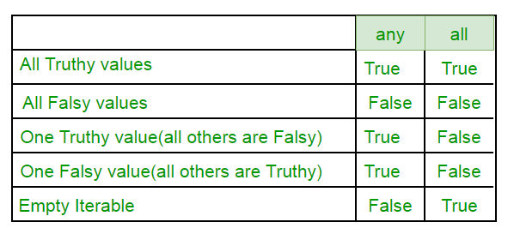
Iterating Through a Dictionary Using a for loop
we can iterate though each key in a dictionary.
Example: squares={1: 1, 3: 9, 5: 25, 7: 49, 9: 81}
for i in squares:
print(squares[i])
Output: 19254981
Built-in Functions with Dictionary
all() Return True if all keys of the dictionary are true(or if the dictionary is empty).
any() Return True if any key of the dictionary is true. If the dictionary is empty, return False.
len() Return the length (the number of items) in the dictionary.
cmp(d1,d2) Compares items of two dictionaries.
sorted() Return a new sorted list of keys in the dictionary.
any( ) & all( )
any(l == 't' for l in 'python') # Returns True. Same as: 't' in 'python’
all(l == 't' for l in 'python') # Returns False. Not all of the letters are 't'.

Slide 95
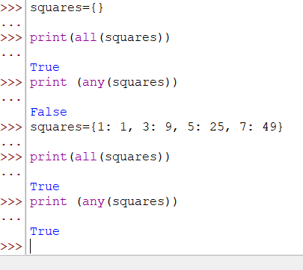
Ex:square={0: 0, 0: 9, 0: 7, 0: 12}
squares={1: 1, 3: 9, 5: 25, 7: 49}
print(len(squares))
print(sorted(squares))
print(cmp(squares,square))# this won’t work in python 3
Output: 4
[1, 3, 5, 7]
1
Ex:
squares={}
print(all(squares))
print (any(squares))
Output:
True
False

Slide 96
Dictionary Methods
str( ) Method
The method str() produces a printable string representation of a dictionary.
Syntax: str(dict)
Example
dict= {'Name': 'Zara', 'Age': 7}
print ("Equivalent String : %s" % str(dict))
Output
Equivalent String : {'Name': 'Zara', 'Age': 7}
copy() Method
The method copy() returns a shallow copy of the dictionary.
Syntax: dict.copy()
Example
dict1 = {'Name': 'Zara', 'Age': 7}
dict2 = dict1.copy()
print ("New Dictinary: %s" % str(dict2))
Output New Dictinary: {'Age': 7, 'Name': 'Zara'}

Slide 97
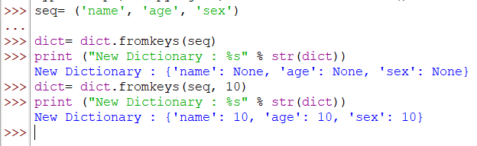
fromkeys( ) Method
The method fromkeys( ) creates a new dictionary with keys from seq and values set to value.
If we don’t specify a value in Dict. it assumes as keyword None
Syntax: dict.fromkeys(seq[, value]))
Example
seq= ('name', 'age', 'sex')
dict= dict.fromkeys(seq)
print ("New Dictionary : %s" % str(dict))
dict= dict.fromkeys(seq, 10)
print ("New Dictionary : %s" % str(dict))
Output

Slide 98
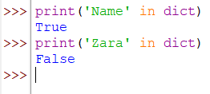
has_key( ) Method
The method has_key() returns true if a given key is available in the dictionary, otherwise it returns a false.
Note: has_key() method was removed in Python 3. Use the in operator instead.
Syntax:
dict.has_key(key)
Example
dict= {'Name': 'Zara', 'Age': 7}
print "Value : %s" % dict.has_key('Age')
print "Value : %s" % dict.has_key('Sex')
Output
Value : True
Value : False

Slide 99

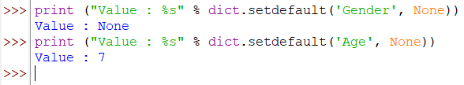
items() Method
The method items() returns a list of dict's(key, value) tuple pairs
Syntax: dict.items()
Example
dict= {'Name': 'Zara', 'Age': 7}
print ("Value : %s" % dict.items())
Output :
setdefault() Method
The method setdefault() is similar to get(), but will set dict[key]=default if key is not already in dict.
Syntax:
dict.setdefault(key, default=None)
Example: dict= {'Name': 'Zara', 'Age': 7}
print ("Value : %s" % dict.setdefault('Age', None))
print ("Value : %s" % dict.setdefault(‘Gender', None))
Output:

Slide 100
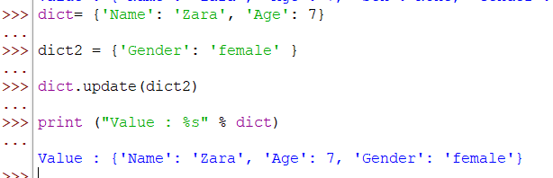

update( ) Method
The method update() adds dictionary dict2's key-values pairs in to dict. This function does not return anything.
Syntax: dict.update(dict2)
Example
dict= {'Name': 'Zara', 'Age': 7}
dict2 = {‘Gender': 'female' }
dict.update(dict2)
print ("Value : %s" % dict)
Output:
values( ) Method
The method values() returns a list of all the values available in a given dictionary.
Syntax: dict.values()
Example dict= {'Name': 'Zara', 'Age': 7}
print ("Value : %s" % dict.values())
Output

